Slide 1
Q6, QM6 element
2015. 4. 7
조영우

Slide 2
Q6 element
2D element with incompatible mode
where,
The element strain
where,
The element stiffness and load matrix
where,

Slide 3
Modified Q6 element (QM6)
The strain energy of the element
Under the state of constant stress, the strain energy associated with the incompatible modes vanishes
The matrix satisfies upper equation
Constant correction matrix
where,
The element stiffness and load matrix
where,

Slide 4
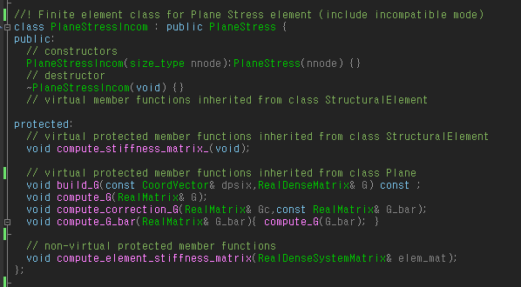
Code

Slide 5
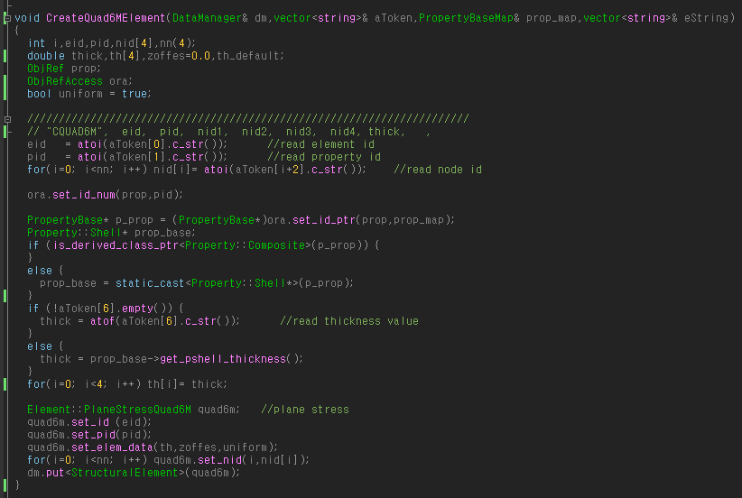
Code

Slide 6
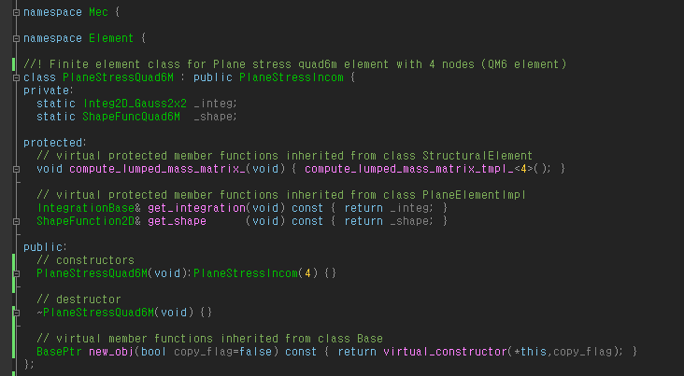
Code

Slide 7
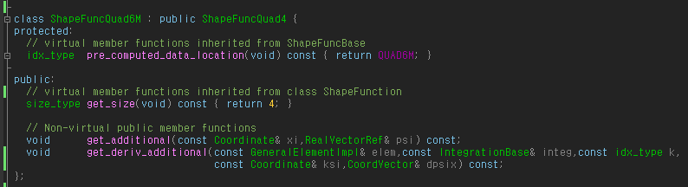
Code

Slide 8
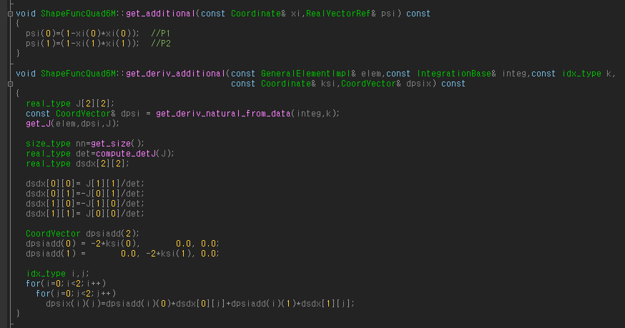
Code

Slide 9
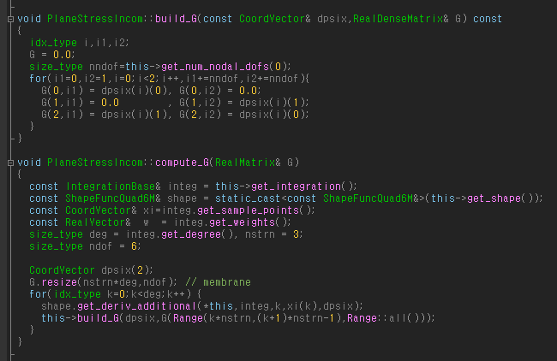
Code

Slide 10
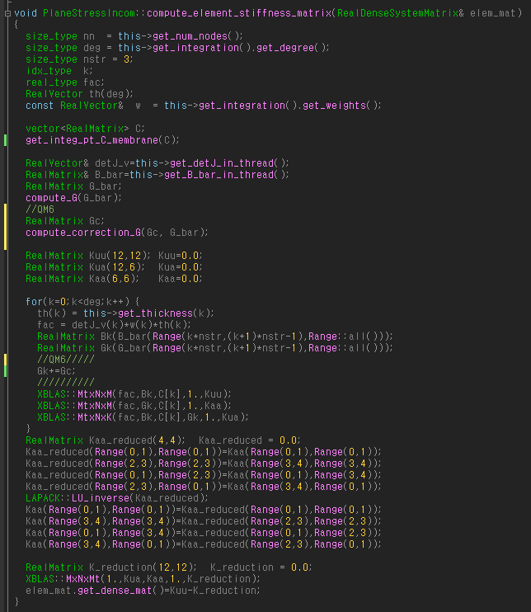
Code

Slide 11
Code

Slide 12
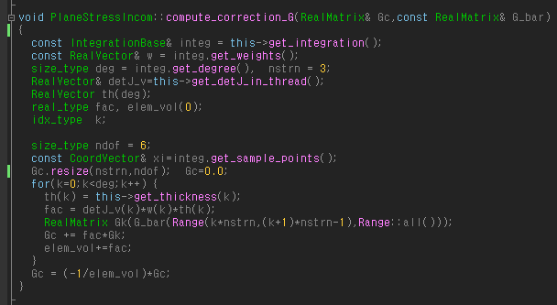
Code

Slide 13
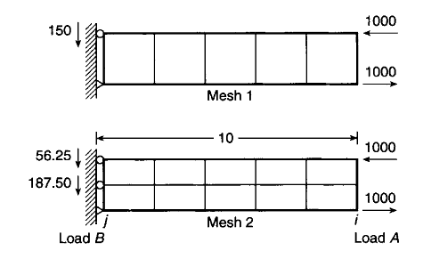
Result
a
b
a
b
Mesh | Load | displacement(@ a)
 |  | CQUAD4(HYB) |  | CQUAD4(FUL) |  | Q6 |  | QM6
5 | moment | -2 | 10 | -1.36364 | 6.818181 | -2 | 10 | -2 | 10
10 |  | -2 | 10 | -1.41177 | 7.058824 | -2 | 10 | -2 | 10
Mesh | Load | displacement(@ b)
 |  | CQUAD4(HYB) |  | CQUAD4(FUL) |  | Q6 |  | QM6
5 | moment | 2 | 10 | 1.363636 | 6.818181 | 2 | 10 | 2 | 10
10 |  | 2 | 10 | 1.411765 | 7.058824 | 2 | 10 | 2 | 10

Slide 14
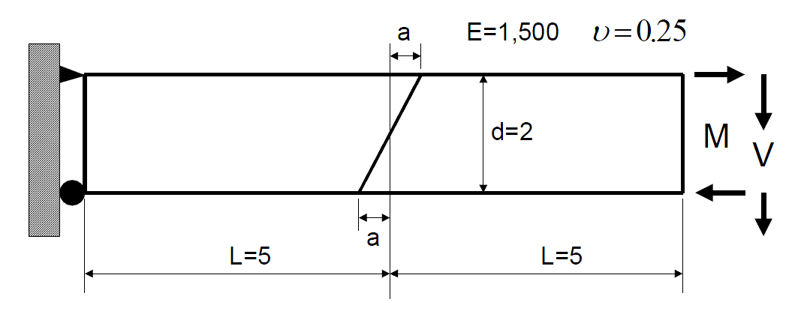
Result
a
b
a | displacement(@ a)
 | CQUAD4(HYB) |  | CQUAD4(FUL) |  | Q6 |  | QM6
0 | 2 | -10 | 0.560748 | -2.80374 | 2 | -10 | 2 | -10
1 | 1.257715 | -6.74873 | 0.282571 | -1.44441 | 1.6621 | -8.6895 | 1.254214 | -6.72868
2 | 1.099422 | -6.31002 | 0.194148 | -0.98199 | 1.706004 | -9.26708 | 1.08877 | -6.24177
a | displacement(@ b)
 | CQUAD4(HYB) |  | CQUAD4(FUL) |  | Q6 |  | QM6
0 | -2 | -10 | -5.60748 | 2.803738 | -2 | -10 | -2 | -10
1 | -1.25772 | -6.28858 | -0.28257 | -1.41285 | -1.6621 | -8.3105 | -1.25421 | -6.27107
2 | -1.09942 | -5.49711 | -0.19415 | -0.97074 | -1.706 | -8.53002 | -1.08877 | -5.44385

Slide 15
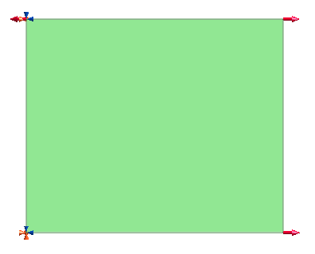
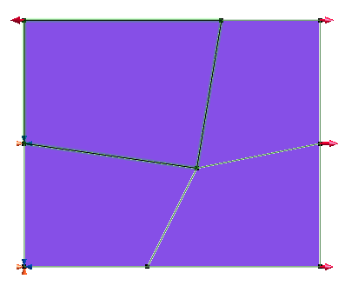
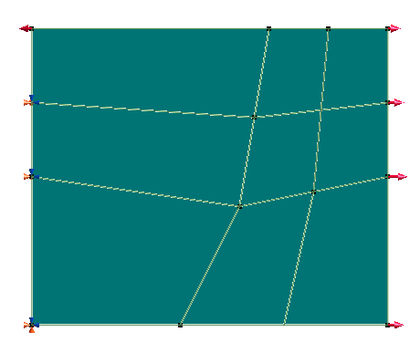
Result
2
1
2
7
1
2
7
1
5
6
5
6
3
4
3
8
4
3
8
4
 |  | STEP 1 |  |  |  | STEP 2 |  |  |  | STEP 3
 |  | QUAD4 (HYB) | QUAD4 (FUL) | Q6 | QM6 | QUAD4 (HYB) | QUAD4 (FUL) | Q6 | QM6 | QUAD4 (HYB) | QUAD4 (FUL) | Q6 | QM6
1 | X | 0.32000 | 0.32000 | 0.32000 | 0.32000 | 0.32000 | 0.32000 | 0.30980 | -0.32000 | 0.32000 | 0.32000 | 0.31786 | 0.32000
 | Y | -0.07466 | -0.07466 | -0.07466 | -0.07466 | -0.07467 | -0.07467 | -0.05407 | -0.07467 | -0.07467 | -0.07467 | -0.06760 | -0.07467
2 | X | 0.00000 | 0.00000 | 0.00000 | 0.00000 | 0.00000 | 0.00000 | -0.00916 | 0.00000 | 0.00000 | 0.00000 | -0.00417 | 0.00000
 | Y | -0.07466 | -0.07466 | -0.07466 | -0.07466 | -0.07467 | -0.07467 | -0.07357 | -0.07467 | -0.07467 | -0.07467 | -0.07772 | -0.07467
3 | X | 0.00000 | 0.00000 | 0.00000 | 0.00000 | 0.00000 | 0.00000 | 0.00000 | 0.00000 | 0.00000 | 0.00000 | 0.00000 | 0.00000
 | Y | 0.00000 | 0.00000 | 0.00000 | 0.00000 | 0.00000 | 0.00000 | 0.00000 | 0.00000 | 0.00000 | 0.00000 | 0.00000 | 0.00000
4 | X | 0.32000 | 0.32000 | 0.32000 | 0.32000 | 0.32000 | 0.32000 | 0.32121 | 0.32000 | 0.32000 | 0.32000 | 0.32206 | 0.32000
 | Y | 0.00000 | 0.00000 | 0.00000 | 0.00000 | 0.00000 | 0.00000 | 0.01296 | 0.00000 | 0.00000 | 0.00000 | 0.00799 | 0.00000
5 | X |  |  |  |  | 0.18667 | 0.18667 | 0.18631 | 0.18667 | 0.18667 | 0.18667 | 0.18709 | 0.18667
 | Y |  |  |  |  | -0.02987 | -0.02987 | -0.01999 | -0.02987 | -0.02987 | -0.02987 | -0.02593 | -0.02987
6 | X |  |  |  |  | 0.32000 | 0.32000 | 0.32664 | 0.32000 | 0.32000 | 0.32000 | 0.32262 | 0.32000
 | Y |  |  |  |  | -0.03733 | -0.03733 | -0.02983 | -0.03733 | -0.03733 | -0.03733 | -0.03489 | -0.03733
7 | X |  |  |  |  | 0.21333 | 0.21333 | 0.20847 | 0.21333 | 0.21333 | 0.21333 | 0.21260 | 0.21333
 | Y |  |  |  |  | -0.07467 | -0.07467 | -0.07270 | -0.07467 | -0.07467 | -0.07467 | -0.07150 | -0.07467
8 | X |  |  |  |  | 0.13333 | 0.13333 | 0.13892 | 0.13333 | 0.13333 | 0.13333 | 0.13665 | 0.13333
 | Y |  |  |  |  | 0.00000 | 0.00000 | 0.00086 | 0.00000 | 0.00000 | 0.00000 | -0.00234 | 0.00000

